Slide 1

Unit 12.3 - Program Testing & Maintenance
Prepared by: Koh Kian Hua

Slide 2
Objectives
After completing this unit, students should be able to:
Show understanding of ways of exposing and avoiding faults in programs
Locate and identify the different types of errors
Correct identified errors
Show understanding of the methods of testing available and select appropriate data for a given method
Show understanding of the need for a test strategy and test plan and their likely contents
Choose appropriate test data for a test plan
Show understanding of the need for continuing maintenance of a system and the differences between each type of maintenance
Analyse an existing program and make amendments to enhance functionality

Slide 3
Program Maintenance & Testing
Avoiding & Exposing Faults in Programs
Programs written to perform a real task will contain errors.
Programmers are human and do make mistakes.
The aim is to avoid making as many mistakes and find as many mistakes as possible before the program goes live.
Fault avoidance can be achieved through the provision of a comprehensive and rigorous program specification at the end of the analysis phase.
Faults or bugs in a program are then exposed at the testing stage and then corrected.

Slide 4
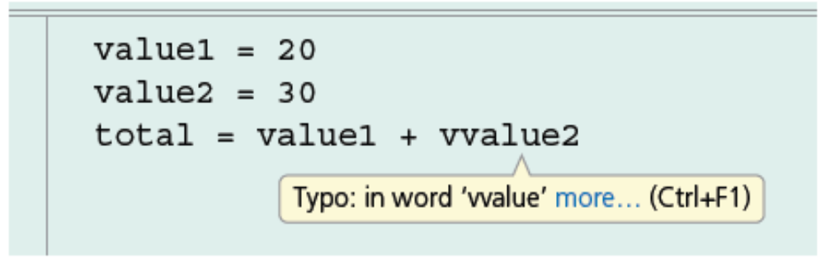
Program Maintenance & Testing
Location, identification and correction of errors
Syntax errors are errors in the grammar of a source program .
When the program is compiled, the syntax of the program is checked, and errors need to be corrected before the program can be executed.
Many IDEs will offer suggestions about what syntax errors are and how to correct them.
Example of a syntax error shown on IDE

Slide 5
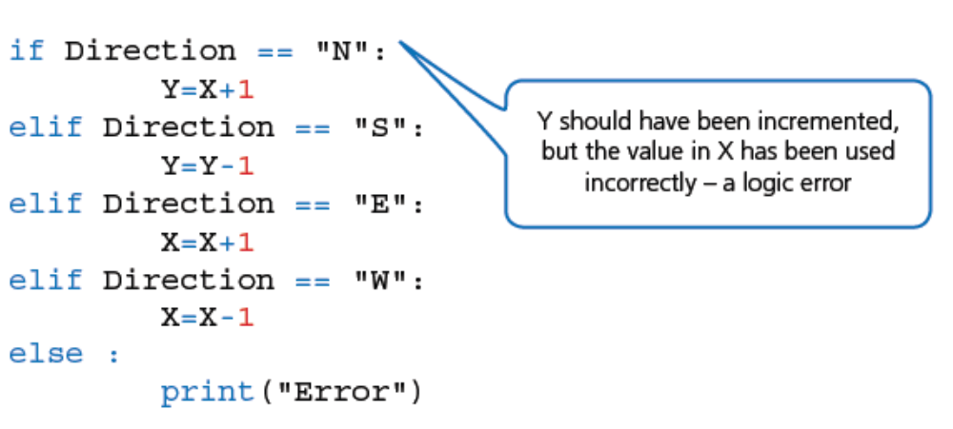
Program Maintenance & Testing
Location, identification and correction of errors
Logic errors are errors in the logic of a program.
This means the program does not do what it is supposed to do.
These errors are usually found when the program is being tested.
Example of a logic error shown on IDE

Slide 6
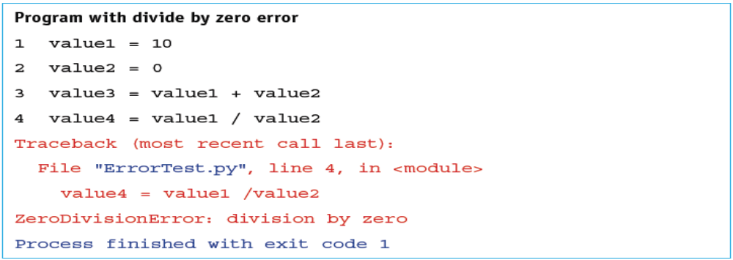
Program Maintenance & Testing
Location, identification and correction of errors
Run-time errors happen when the program is executed.
The program may halt unexpectedly or go into an infinite loop and need to be stopped by brute force.
Example of a Run-time error

Slide 7
Program Maintenance & Testing
Location, identification and correction of errors
Run-time errors happen when the program is executed.
The program may halt unexpectedly or go into an infinite loop and need to be stopped by brute force.
In the program has been release and a run-time error occurs, the program can be updated and re-released a patch to solve the problem.
Example of a Run-time error

Slide 8
Program Maintenance & Testing
Program Testing
Programs need to be rigorously tested before they are released.
Tests should be documented to show that the program is robust and ready for general use.
There needs to be a test strategy set out in the analysis stage of the program development lifecycle.
A test plan is drawn up to show all the stages of every test that will be performed.
The results of the tests can be added to the plan showing that the program has met its requirements.

Slide 9
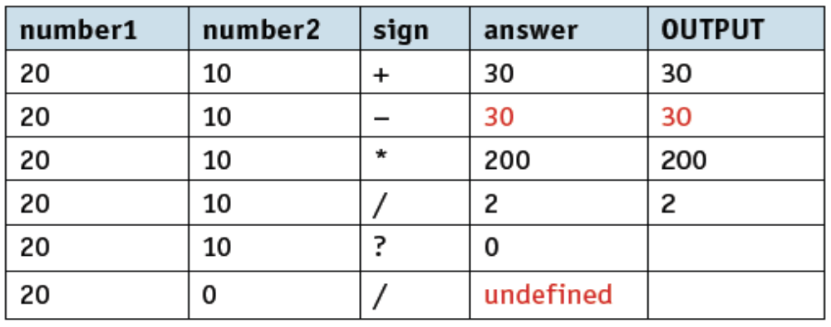
Program Maintenance & Testing
Program Testing
During the testing phase, the programmer can manually and document the results using a trace table.
The sample trace table below shows the value of each variable and any output.
The errors found in the routine by performing the testing have been highlighted in red.

Slide 10
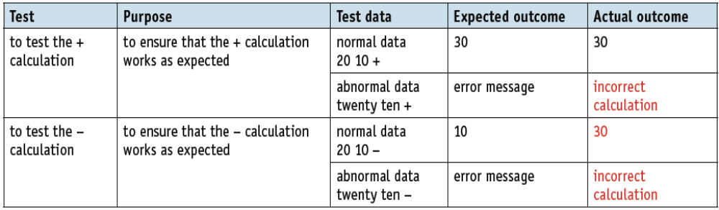
Program Maintenance & Testing
Program Testing
A walkthrough is a formalised version of a dry run using pre-defined test cases.
The developer takes the team members through the dry run process, often done as a demonstration.
Each module is tested as set out in the test plan often as a form of a table.

Slide 11
Program Maintenance & Testing
Program Testing
Several types of test data need to be used during testing:
Normal test: data that is to be accepted by a program and is used to show that the program is working as expected.
Abnormal test: data that should be rejected by a program as it is unsuitable or could cause problems.
Extreme test: data that is on the limit of that accepted by a program;
  for example, when testing a validation rule such as number >= 12 AND number <= 32 the extreme test data would be 12 at the lower limit and 32 at the upper limit; both these values should be accepted.
Boundary test: data that is on the limit of that accepted by a program or data that is just outside the limit of that rejected by a program;
  For example, when testing a validation rule such as number >= 12 AND number <= 32 the boundary test data would be 12 and 11 at the lower limit and 32 and 33 at the upper limit; 12 and 32 should be accepted, 11 and 33 should be rejected.

Slide 12
Program Maintenance & Testing
Program Testing
As the program is being developed the following types of testing are used:
White-box testing is the detailed testing of how each procedure works. This involves testing the structure and logic of every path through a program module.
Black-box testing tests a module’s inputs and outputs.
Integration testing is the testing of any separately written modules to ensure that they work together, during the testing phase of the program development lifecycle.
  If any of the modules have not been written yet, this can include stub testing, which makes use of dummy modules for testing purposes.

Slide 13
Program Maintenance & Testing
Program Testing
When the program has been completed, it is tested as a whole:
Alpha testing is used first. The completed, or nearly completed, program is tested in-house by the development team.
Beta testing is then used. The completed program is tested by a small group of users before it is generally released.
Acceptance testing is then used for the completed program to prove to the customer that it works as required in the environment in which it will be used.

Slide 14
Program Maintenance & Testing
Program Maintenance
Sometimes, programs might not work correctly in unforeseen circumstances.
Logic or run-time errors that require correction may occur from time to time, or users may want to use the program in a different way.
Program maintenance can usually be divided into three categories:
Corrective maintenance: is used to correct any errors that appear during use, for example trapping a run-time error that had been missed during testing.
Perfective maintenance: is used to improve the performance of a program during its use, for example improving the speed of response.
Adaptive maintenance: is used to alter a program so it can perform any new tasks required by the customer, for example working with voice commands as well as keyboard entry.

